Slide 1

Style Sheet
Objectives
After completion of this section the student will be able to:
Identify the meaning and purpose of Style Sheet.
Open up a workspace for creating new CSS documents.
Identity the uses of CSS execution order.
Create a HTML document using External, Internal and Inline Style Sheet.
Identify the CSS syntaxes in HTML Document.
Identify the use of various CSS formatting Tags .

Slide 2
Introduction
The World Wide Web Consortium (W3C) - the non profit, standard setting consortium responsible for standardizing HTML - created STYLES in addition to HTML 4.0. Both Netscape 4.0 and Internet Explorer 4.0 support Cascading Style Sheets (CSS).
Styles in HTML 4.0 define how HTML elements are displayed, just like the font tag and the color attribute in HTML 3.2.
Styles are normally saved in files external to the HTML documents.

Slide 3
Introduction Contd..
External style sheets enable us to change the appearance and layout of all the pages in the Web, just by editing a single CSS document.
CSS allowed developers to control the style and layout of multiple Web pages all at once.
Web developers can also define a style for each HTML element and apply it to as many Web pages as they want.
To make a global change, simply change the style in one document, and all elements in the Web are updated automatically.

Slide 4
Syntax
The CSS syntax is made up of three parts: a selector, a property and a value:
selector {property: value}
The selector is normally the element/tag we wish to define, the property is the attribute we wish to change, and each property can take a value. The property and value are separated by a colon and surrounded by curly braces:
body {color: black}
If the value is multiple words, put quotes around the value:
p {font-family: "sans serif"}

Slide 5
Syntax Contd..
If we wish to specify more than one property, we should separate each property with a semi-colon. The example below shows how to define a center aligned paragraph, with a red text color:
p {text-align: center; color: red}
To make the style definitions more readable, we can describe one property on each line, like this:
p
{
text-align: center;
color: black;
font-family: arial
}

Slide 6
Syntax Contd..
Grouping
We can group selectors. Separate each selector with a comma.
In the example below we have grouped all the header elements. Each header element will be green:
h1, h2, h3, h4, h5, h6
{
color: green
}

Slide 7
Syntax Contd..
The class Attribute
The class attribute can be used define different styles for the same element.
If we would like to have two types of paragraphs in your document: one right-aligned paragraph, and one center-aligned paragraph. Here is how we can do it with styles:
p.right {text-align: right}
p.center {text-align: center}
Using the class attribute in the HTML document:
<p class="right">
This paragraph will be right-aligned.
</p>

Slide 8
Syntax Contd..
<p class="center">
This paragraph will be center-aligned.
</p>
We can also omit the tag name in the selector to define a style that can be used by many elements:
.center {text-align: center}
In the code below both the h1 element and the p element are classed with "center".
<h1 class="center">
This heading will be center-aligned
</h1>
<p class="center">
This paragraph will also be center-aligned.
</p>

Slide 9
Syntax Contd..
The id Attribute
The id attribute has to be unique on the page. There can only be one element with a given id in a document.
They are marked in the HTML document with id instead of class:
<p id="intro">
This paragraph will be right-aligned.
</p>
The id attribute can be defined in two ways. It can be defined to match all elements with a particular id, or to match only one element with a particular id.

Slide 10
Syntax Contd..
In this example, the id attribute will match all elements with id="intro":
#intro
{
font-size:110%; font-weight:bold; color:#0000ff;
background-color:transparent
}
In this example, the id attribute will match only p elements with id="intro":
p#intro
{
font-size:110%; font-weight:bold; color:#0000ff;
background-color:transparent
}

Slide 11
Syntax Contd..
CSS Comments
A comment will be ignored by the browser.
A CSS comment begins with "/*", and ends with "*/", like this:
/* This is a comment */
p
{
text-align: center;
/* This is another comment */
color: black;
font-family: arial
}

Slide 12
Inserting a Style Sheet
When a browser reads a style sheet, it will format the document according to it.
There are three ways of inserting a style sheet.
External Style Sheet
An external style sheet is ideal when the style is applied to many pages.
With an external style sheet, we can change the look of an entire Web site by changing one file.
Each page must link to the style sheet using the <link> tag.

Slide 13
Inserting a Style Sheet Contd..
The <link> tag goes inside the head section:
<head>
<link rel="stylesheet" type="text/css" href="mystyle.css" >
</head>
The browser will read the style definitions from the file mystyle.css, and format the document according to it.
An external style sheet can be written in any text editor. The file should not contain any html tags. The style sheet should be saved with a .css extension. An example of a style sheet file is shown below:
hr {color: red}
p {margin-left: 20px}
body {background-image: url("images/back40.gif")}

Slide 14
Inserting a Style Sheet Contd..
Internal Style Sheet
An internal style sheet should be used when a single document has a unique style.
We define internal styles in the head section by using the <style> tag, like this:
<head>
<style type="text/css">
hr {color: red}
p {margin-left: 20px}
body {background-image: url("images/back40.gif")}
</style>
</head>
This will only make the style changes particular to the HTML page where it occurred.

Slide 15
Inserting a Style Sheet Contd..
Inline Styles
An inline style loses many of the advantages of style sheets by mixing content with presentation.
Use this method sparingly, such as when a style is to be applied to a single occurrence of an element.
To use inline styles we use the style attribute in the relevant tag.
The style attribute can contain any CSS property.
The example shows how to change the color and the left margin of a paragraph:
<p style="color: sienna; margin-left: 20px">
This is a paragraph
</p>

Slide 16
Multiple Styles Cascading
Style Sheets allow style information to be specified in many ways.
Styles can be specified inside a single HTML element, inside the <head> element of an HTML page, or in an external CSS file.
Even multiple external Style Sheets can be referenced inside a single HTML document.

Slide 17
Multiple Styles Cascading Contd..
Multiple Style Sheets
If some properties have been set for the same selector in different style sheets, the values will be inherited from the more specific style sheet.
For example, an external style sheet has these properties for the h3 selector:
h3
{
color: red;
text-align: left;
font-size: 8pt
}

Slide 18
Multiple Styles Cascading Contd..
And an internal style sheet has these properties for the h3 selector:
h3
{
text-align: right;
font-size: 20pt
}
If the page with the internal style sheet also links to the external style sheet the properties for h3 will be:
color: red;
text-align: right;
font-size: 20pt
The color is inherited from the external style sheet and the text-alignment and the font-size is replaced from the internal style sheet.

Slide 19
Multiple Styles Cascading Contd..
Cascading Order
All the styles will "cascade" into a new "virtual" Style Sheet by the following rules, where number four has the highest priority:
  Inline Style (inside HTML element)
  Internal Style Sheet (inside the <head> tag)
  External Style Sheet
  Browser default

Slide 20
CSS Background
The Background properties allow us to control the background color of an element, set an image as the background, repeat a background image vertically or horizontally, and position an image on a page.
The sample program with various CSS Background properties is as under:
<html>
<head>
<style type="text/css">
body
{
background-color: #00ff00;
background-image: url("x.gif");

Slide 21
CSS Background Contd..
background-attachment: fixed;
background-position: center
}
</style>
</head>
<body>
<p>
<b>Note:</b>
The background-attachment and the background-position properties do not work in Netscape 4.0.
</p>
<p>We are the best</p>
<p>We are the best</p>
<p>We are the best</p>
</body>
</html>

Slide 22
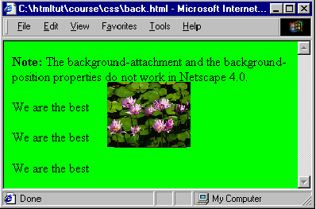
CSS Background Contd..
The code when executed on web browser would look as:

Slide 23
CSS Text
Text properties allow us to control the appearance of text. It is possible to change the color of a text, increase or decrease the space between characters in a text, align a text, decorate a text, indent the first line in a text, and more.
The sample program with various CSS Text properties is as under:
<html>
<head>
<style type="text/css">
h1 {color: blue; letter-spacing: 0.5cm; text-align: center; text-decoration: line-through}
h2 {color: #dda0dd; letter-spacing: -3px; text-align: right; text-decoration: overline}

Slide 24
CSS Text Contd..
h3 {text-align: left; text-decoration: underline}
p {color: rgb(255,0,0); text-indent: 1cm; text-transform: uppercase}
a {text-decoration: none}
</style>
</head>
<body>
<h1>Welcome to </h1>
<h2> Computer Education</h2>
<h3>Introduction</h3>
<p> Computer Education is one of the Strategic Business Unit of Limited (A Govt. of India Enterprise). We believe in Empowering your future by providing quality IT education.</p>
<a href="http://www.ltd.com"> Limited</a>
<br>

Slide 25

CSS Text Contd..
<p style= "text-transform: capitalize; text-indent: -1px; color: black"><b>Note:</b> Netscape 4 does not support the "letter-spacing" property.</style>
</body>
</html>

Slide 26
CSS Borders
The Border properties allow you to specify the style, color, and width of an element's border.
The sample program with various CSS Font properties is as under:
<html>
<head>
<style type="text/css">
h1 {border-style: dotted; border-color: #0000ff; border-bottom-width: 15px}
h2 {border-style: dashed; border-top-width: 15px}
p {border-style: double groove; border-color: #ff0000 #00ff00 #0000ff rgb(250,0,255); border-width: 5px}
</style>

Slide 27
CSS Borders Contd..
</head><body>
<h1> Welcome to Computer Education </h1>
<h2> Introduction </h2>
<p> Computer Education is one of the Strategic Business Unit of Limited (A Govt. of India Enterprise). we believe in Empowering your future by providing quality IT education.</p>
<b><u>Note:</u></b>Netscape 6 and Internet Explorer 5.5 supports all border styles.
<br>The "border-style" property is not recognized by Netscape 4 while Internet Explorer 4.0 - 5.0 does not support the "dotted" and "dashed" values.
<br>The "border-color" and "border-bottom-width" property are not recognized in Internet Explorer if they are used alone. Use the "border-style" property to set the borders firstin Internet Explorer.
</body> </html

Slide 28
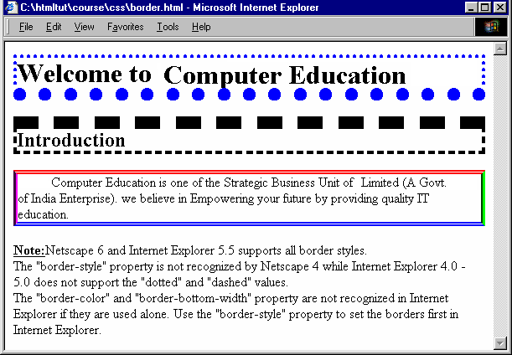
CSS Borders Contd..
The code when executed on web browser would look as:

Slide 29
CSS List
The List properties define the type of lists that can be built with Style Sheet.
Lists can have bullets, numbers and graphics included.
The sample program with various CSS Font properties is as under:
<html>
<body>
<ul style= "list-style-type: disc; list-style-position: outside">
<li>Coffee</li>
<li>Tea</li>
<li>Cold Drink</li>
</ul>

Slide 30
CSS List Contd..
<ol style="list-style-type: lower-roman; list-style-position: inside">
<li>Coffee</li>
<li>Tea</li>
<li>Cold Drink</li>
</ol>
<ul style="list-style-image: url(bullet1.gif); list-style-position: outside">
<li>Coffee</li>
<li>Tea</li>
<li>Coca Cola</li>
</ul>
<p><b>Note:</b> Netscape 4 does not support the "list-style-image" and "list-style-position" properties.</p>
</body>
</html>

Slide 31
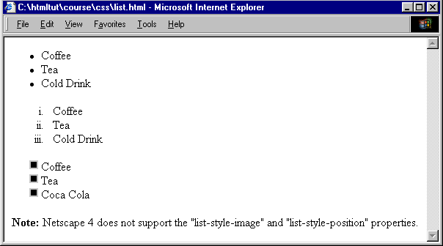
CSS List Contd..
The code when executed on web browser would look as:

Slide 32
CSS Dimensions
The Dimension properties are used to set the height and width of an Image.
They are also used to increase the space between the lines.
The sample program with various CSS Font properties is as under:
<html>
<body>
<img src= "x.gif" style="height:auto; width=auto" >
<br>
<img src= "x.gif" style="height:80px; width=100px">
<br>
<img src= "x.gif" style="height:10%; width=10%">

